Slide 1
Arduino Communication
Arduino Library functions
The Library is considered as the advanced feature, which extends the capabilities of the Arduino
IDE. It means that the libraries provide extra functionality to the programming platform of Arduino.
The libraries in Arduino are written in C or C++ (.cpp). These libraries allow us to manipulate data and work with the hardware.
To implement any Library in the Arduino IDE, go to the Sketch -> Import Library. There are several libraries available for download. We can also create our own library.

Slide 2
Standard Libraries
The standard libraries are listed below:
EEPROM: It stands for Electronic Erasable Programmable Read Only Memory. The EEPROM is associated with the microcontroller present on the AVR or Arduino Boards. The EEPROM library allows us to read the bytes stored in the memory when the power of the board is off. The size of EEPROM varies in different boards, such as 1KB or 1024 bytes on the ATmega328P. It can also be of 4KB or 4096 bytes on the Microcontroller ATmega2560, etc. The library is declared as:
#include <EEPROM.h>
For example, EEPROM Read, EEPROM Clear, EEPROM Write, EEPROM Get, EEPROM Update, EEPROM Put, EEPROM Iteration, etc.

Slide 3
Ethernet Library: The Ethernet library works with the Arduino Ethernet shield and other related devices. The Ethernet library allows us to connect the Arduino board to the Internet. The SPI bus acts as an intermediate between the board and the shield.
The associated library is:
#include <Ethernet.h>
#include <SPI.h>
For example, TelnetClient, WebServer, WebClientRepeating, WebClient, ChatServer, DnsWebClient, UdpNtpClient, UdpSendReceiveString, etc.

Slide 4
Liquid Crystal Library: It is a library that permits Arduino to communicate with LCDs, which are based on a compatible chipset called Hitachi HD44780. Such chipsets are found on most types of text-based LCDs. It works with either an 8-bit mode or 4-bit mode. Here, the bit mode signifies the data lines in addition to the enable, rs, and rw control lines (optional).
The library is declared as:
#include <LiquidCrystal.h>
The examples are Hello World, Cursor, Blink, etc.

Slide 5
SD Library: It allows writing to or reading from SD cards. For example, Arduino Ethernet Shield. The file names include the paths separated by the forward slashes, which are passed to the SD Library. But SPI is used for the communication between the SD card and the Arduino. The library is declared as:
#include <SPI.h>
#include <SD.h>
The examples are Dump files, List Files, Read Write, etc.
Stepper Library: The Stepper library in Arduino permits to control of bipolar or unipolar stepper motors.
The library is declared as:
#include <Stepper.h>
The Stepper includes stepper speed control, stepper one revolution, etc.

Slide 6
Software Serial Library: The Software Serial Library permits serial communication over digital Input/output pins. The 0 and 1 pins are inbuilt on Arduino for the serial interface. We can include multiple serial ports in our code that can operate with speed upto 115200 bps (bits per second).
The library is declared as:
#include <SoftwareSerial.h>
WiFi Library: The WiFi library permits Arduino to establish a connection with the internet. It can either be a server to receive the incoming connections or a client to perform outgoing connections.
The personal encryptions supported by the WiFi library are WPA2 and WEP except for WPA2 Enterprise. Arduino uses the SPI bus to communicate with the WiFi shield.
The library is declared as:
#include <WiFi.h>
The examples include WiFiWebClient, WiFiWebServer, etc.

Slide 7
Audio Library: The Audio library is compatible with the Arduino Due board only. It enables the board to playback .wav files from the specific storage devices, such as the SD card.
It plays sounds by using the DAC0 and DAC1 pins. The library is declared as:
#include <Audio.h>
The example is a Simple Audio Player.

Slide 8
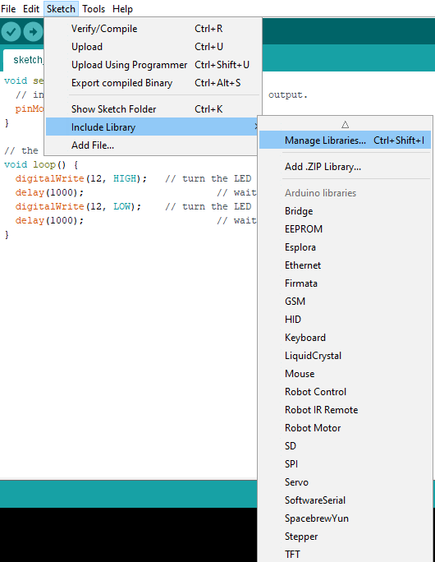
How to install a library in Arduino?
The steps are listed below:
Arduino Library Manager
o We need to open the library manager to install a new library in Arduino.
Click on Sketch-> Include Library -> Manage Libraries, as shown here.

Slide 9
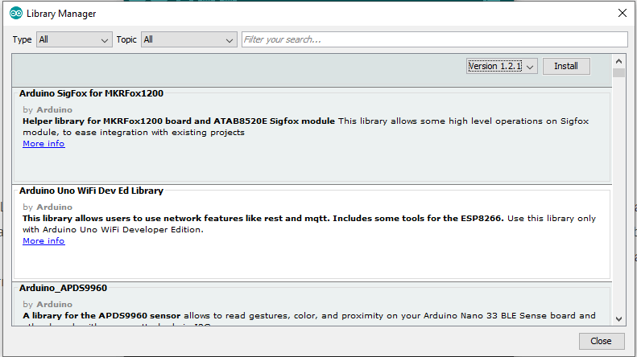
o A dialog box containing various libraries will appear, as shown below:

Slide 10
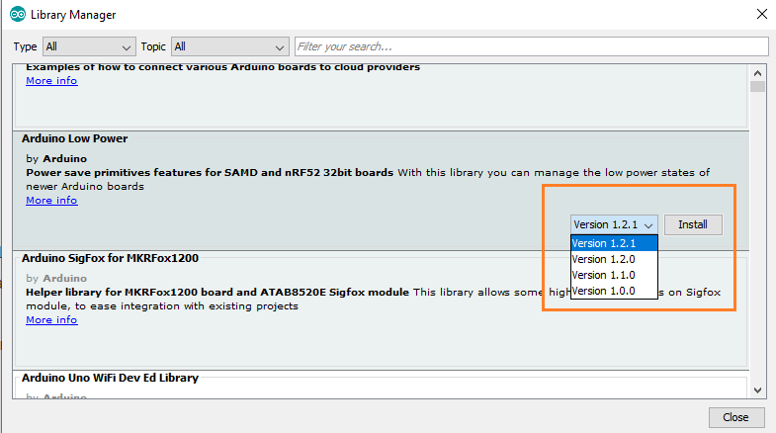
o A list of libraries will appear that are ready to install. We need to select the specific library -> select the version -> click on Install button, as shown below:

Slide 11
Sometimes there is only one version available for download. In such case, the dropbox of the version will not appear. Hence, it's normal. We need to wait for the library to download. The downloading will depend on the connection speed.
The 'INSTALLED' tag will appear in front of the library that is already installed on our computer.
Importing a .zip Library
If we want to add our own library, we can select the desired folder from our computer. The
particular zip file containing the library can be imported in the Arduino. It is shown in the image.

Slide 12
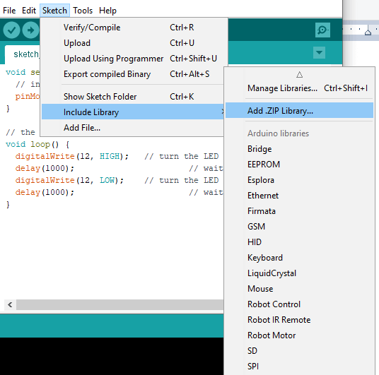
We can also recheck from the option Sketch -> Include library to see that the added libraries are present or not on the list. We are not required to unzip the downloaded library. The file will remain in the .zip format. We can download the 3rd party libraries starting with the Arduino IDE version 1.0.5.

